Slide 1
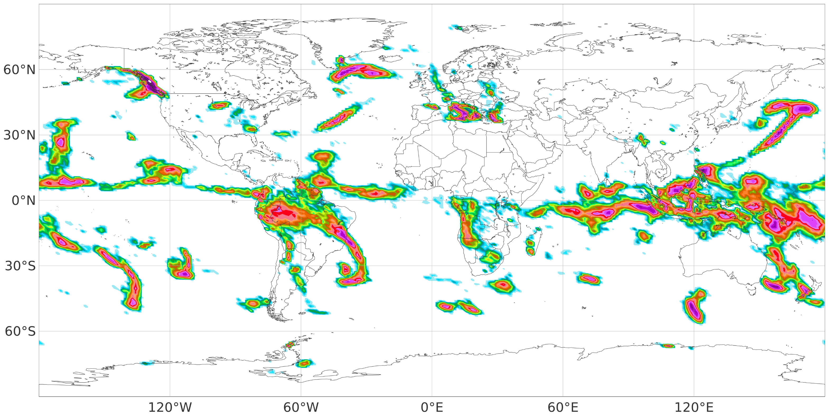
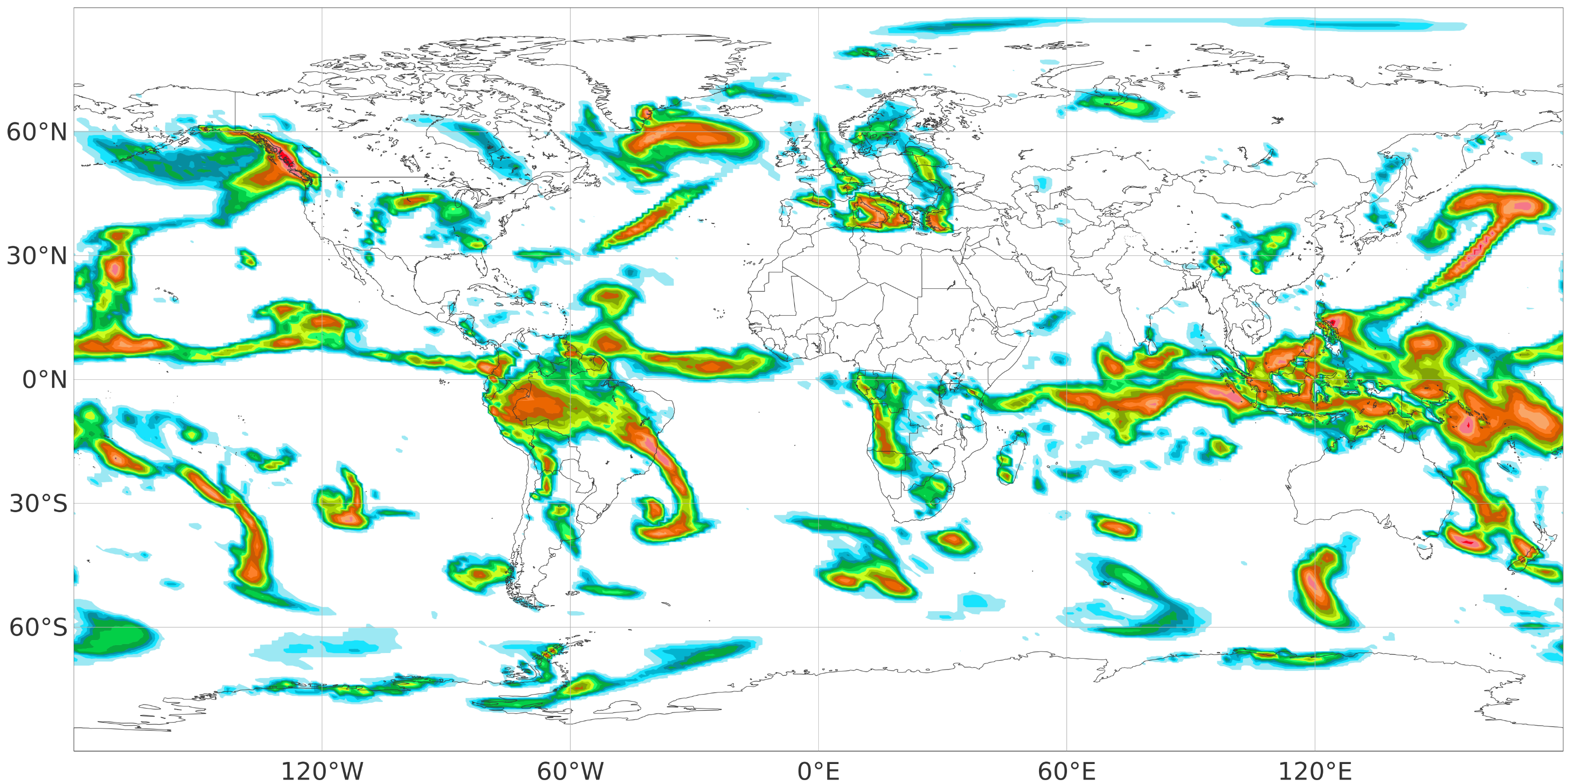
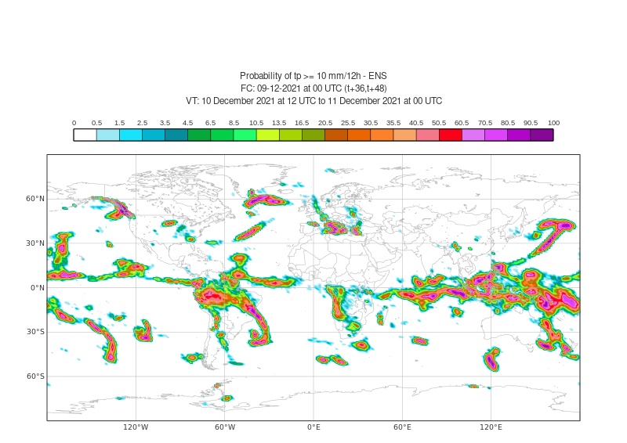
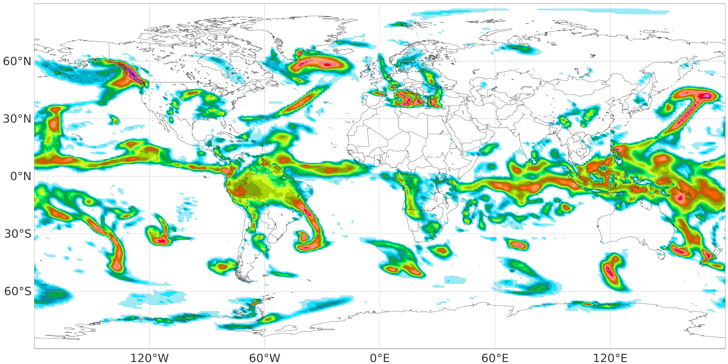
Probability [%] of tp >= 10 mm/12h
FC: 09-12-2021 at 00 UTC (t+36,t+48), VT: 10th December 2021 at 12 UTC and 11th December 2021 at 00 UTC
(a) ECMWF ENSemble forecasts (ENS)
%
100
90.5
80.5
70.5
60.5
50.5
40.5
(b) Univariate ecPoint (U-ecPoint)
35.5
30.5
25.5
20.5
16.5
13.5
10.5
(c) Multivariate ecPoint (M-ecPoint)
8.5
6.5
4.5
3.5
2.5
1.5
0.5
0

